Slide 1

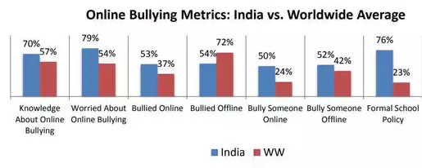
Anti-CyberBullying
Team Name: Tangents
Suppression of Cyber-bullying - An API to detect abusive/profane comments on social forum Tagline - Prevention is better than cure
The increasing access to Internet has led to the threat of the ‘faceless evil’ of cyberbullying, with teenagers being the most vulnerable victims.
The scope of cyberbullying is vast,including bullying through text messages,e-mails,instant messengers, social media platforms, or in chat rooms varing from posting hurtful words, derogatory comments, false information for personal vendetta to rape or death threats without the consent of the subject and in order to cause them distress or embarrassment
The impact of such acts can be catastrophic, especially for young adults, who feel so embarrassed and humiliated that they cannot imagine surviving the next morning, and end up taking extreme steps which include harm to self.

Slide 2


Current measures on social forums
A comment is posted on the forum People need to report the abusive/profane comment Report count must exceed the threshold Comment is then removed from the forum
Drawback of current methods
Only when report count exceeds threshold, the comment is removed People already view these comments, causing embarassment to the subject Direct bully messages sent are snot avoided
Our approach to deal with Cyber-bullying (Preventive approach)
The direct messages detected as bully are not sent to the subject Comments on posts that are hurtful or profane are never posted on the forum. If a user is noticed to send more than 10 profane comments or abusive messages, he/she is blocked from sending messages or comments on posts

Slide 3
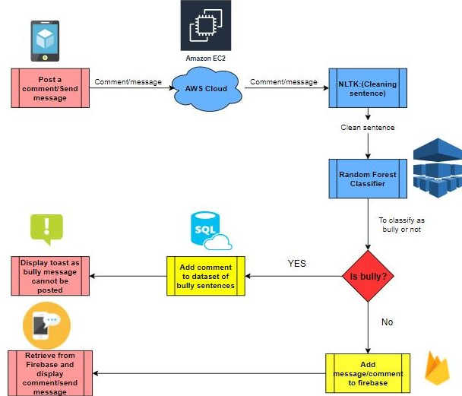

Idea
Description
Our API - Any social forum like Whatsapp, Quora, Instagram, Facebook can call our API to detect the profane/abusive comments posted or directly messaged to the users and hence not posting them on the forum or sending the message to the victim. Since we have deployed the model as an API, it is easily scalable, can be used by all forums and is not restricted to an app. We provide upto 80% accuracy in detecting bully comments.
Call API hosted on Heroku
LSTM
and
RNN

Slide 4
Technology Stack
Libraries/Algorithms/ Platforms | Functions | Justification
Natural language processing toolkit | To process and clean the comments posted by users | Porter Stemmer and regular expression functionalities
LSTM and RNN (TensorFlow backend) | To classify comments as bully or non-bully | Tried and tested for better accuracy
Android studio | To build the Mobile application | Demonstration purpose to show the complete working
Flask | To create the REST API | Easy scalability
Heroku | To host the code on server | Cost effective to developer
Volley | To make requests to the REST API from the mobile app | Easy to implement
Firebase | Used for authentication of users and to have a database | Cost-effective, Easy to implement for prototype
We are using a dataset from kaggle to train our model.Click here to see the dataset

Slide 5
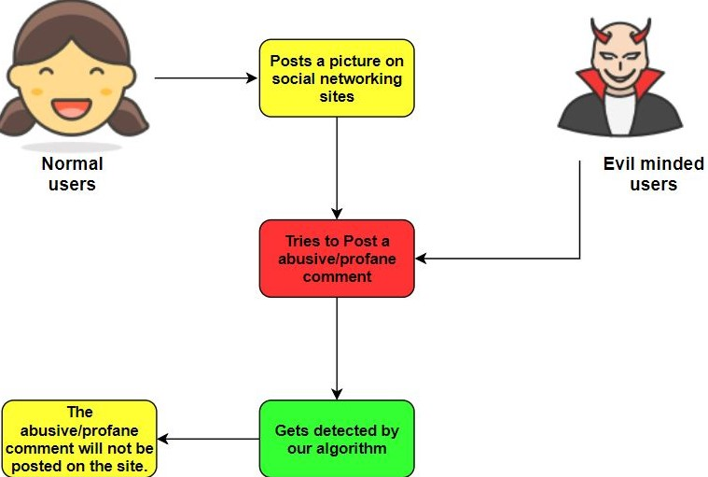
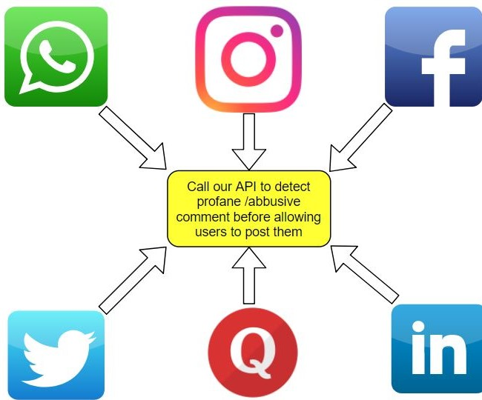
Use cases

Slide 6
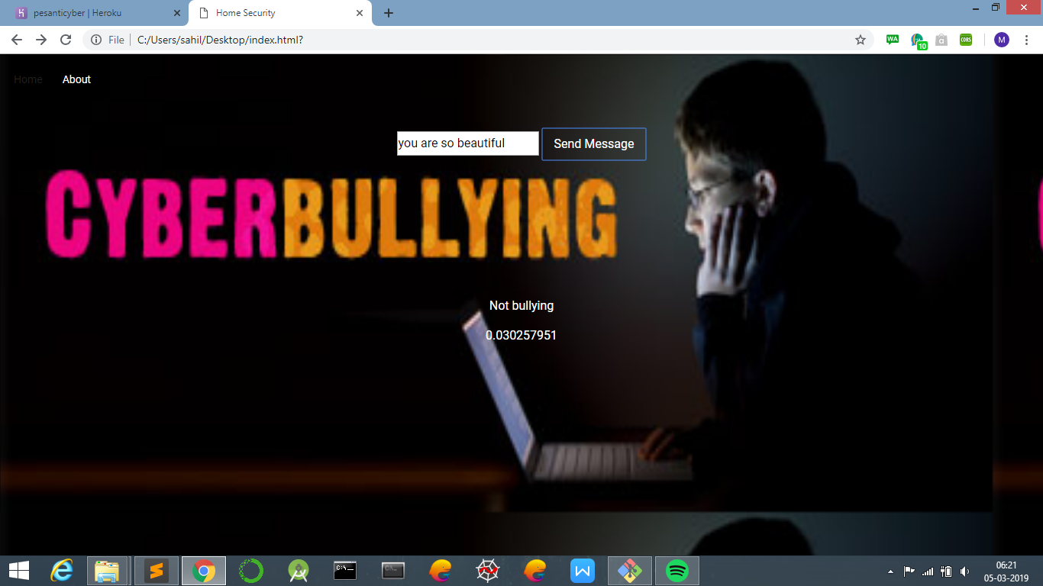

Slide 7


Slide 8
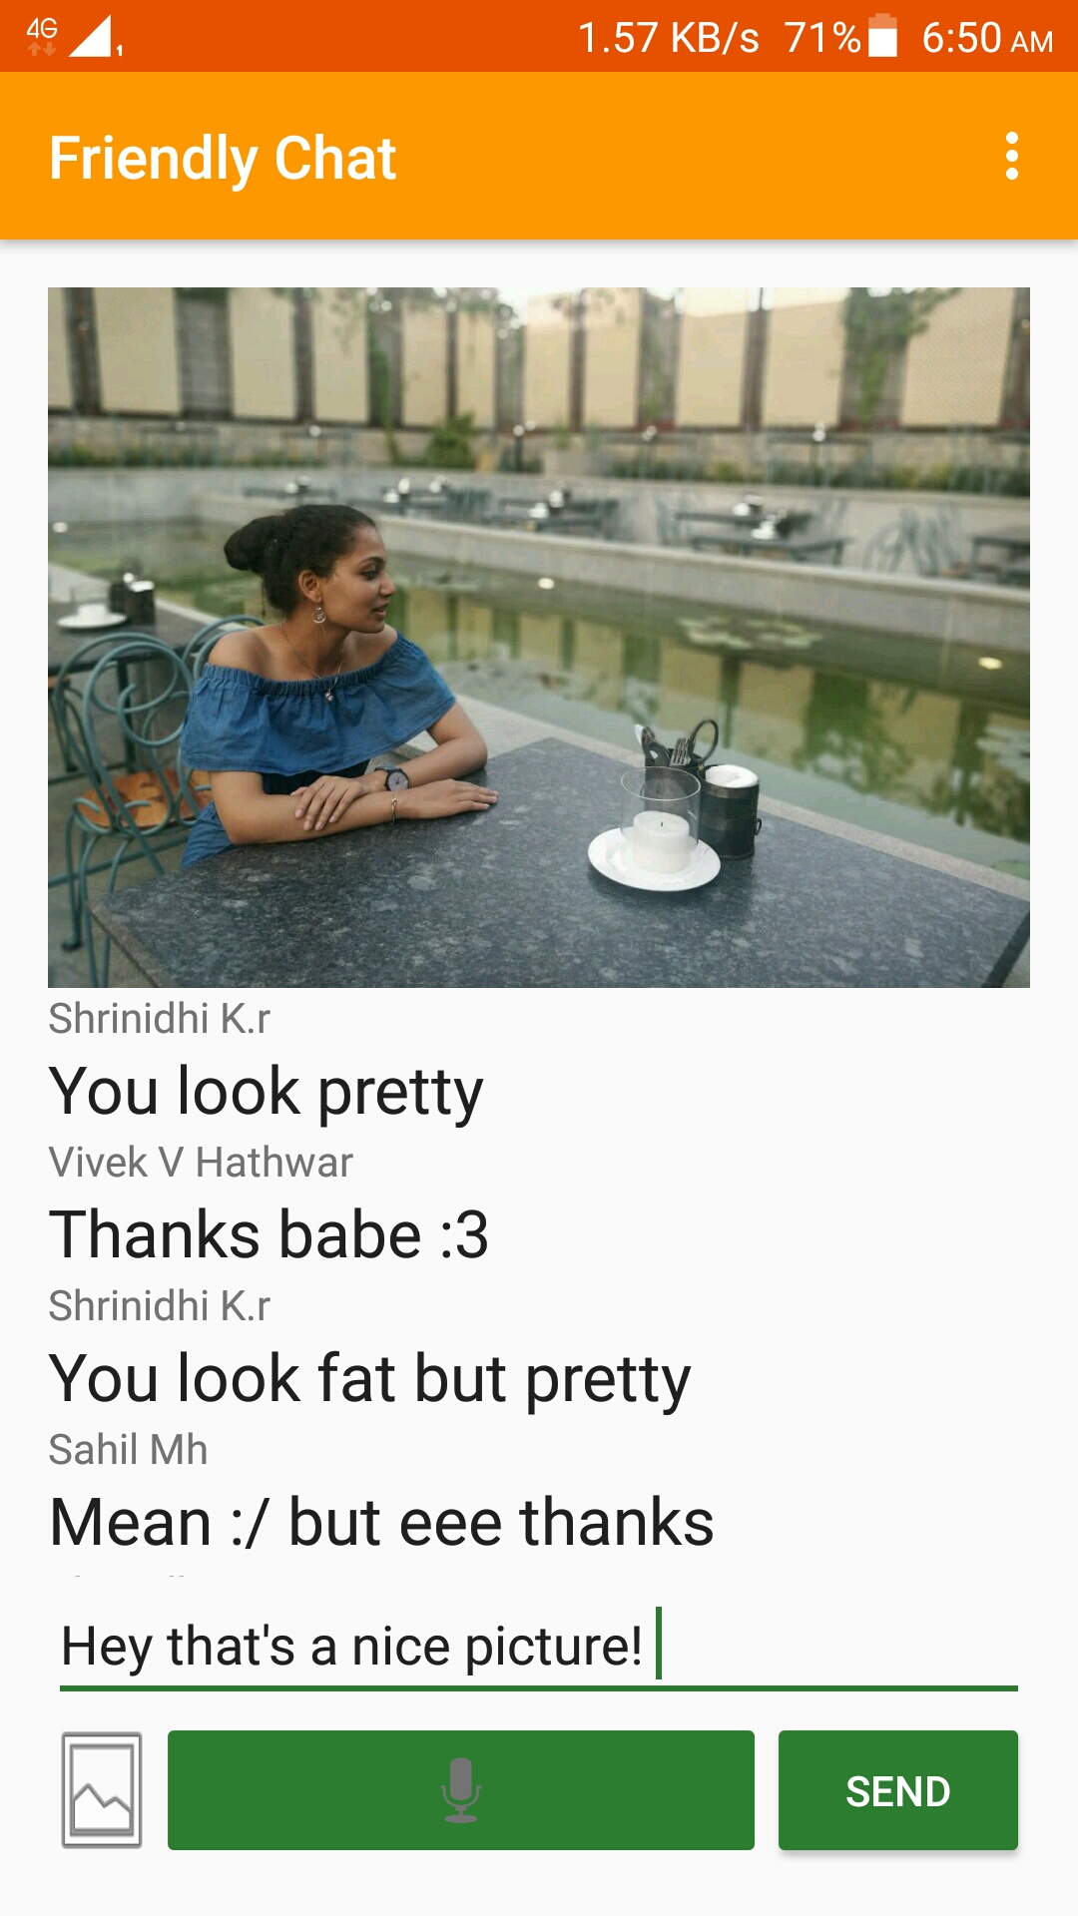
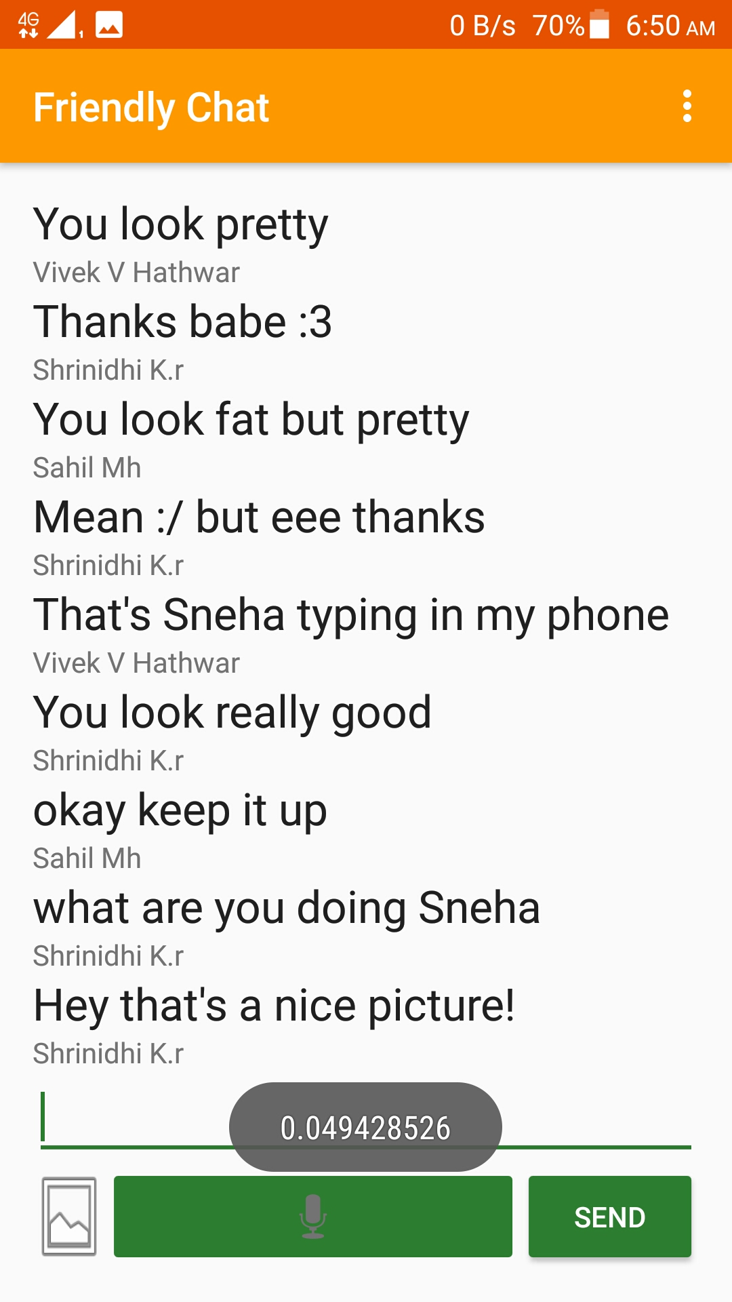
UI of Simple Chat App

